Slide 1
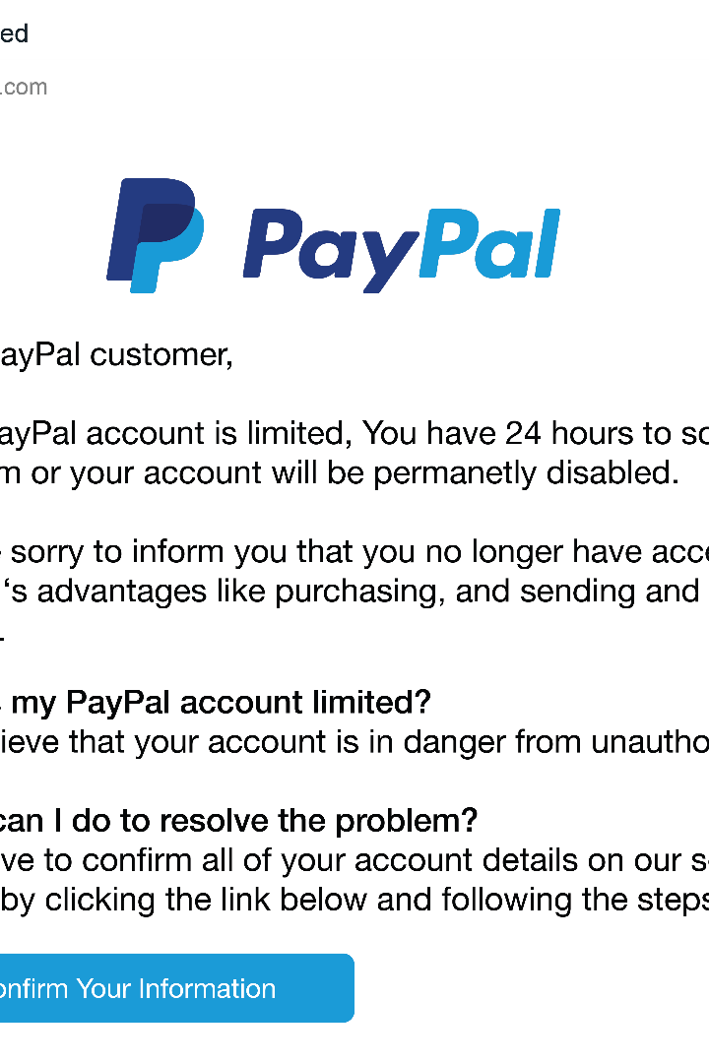

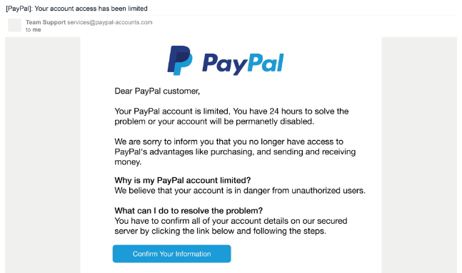

Introduction to Phishing Attacks
Phishing attacks are a type of social engineering tactic that manipulate people into revealing sensitive information or performing actions that compromise security. This training will teach you how to recognize and avoid these deceptive scams.

Slide 2
Understanding Phishing Tactics
Impersonation
Urgency & Threats
Malicious Links & Attachments
Phishers often try to impersonate trusted organizations, brands, or individuals to build a false sense of legitimacy.
Phishing emails create a false sense of urgency or threaten consequences to pressure victims into acting quickly.
Phishers try to lure victims into clicking on malicious links or downloading infected files to compromise their devices.

Slide 3
Identifying Phishing Emails
1
Sender Address
2
Greetings & Personalization
Look for suspicious or spoofed email addresses that don't match the claimed sender.
Generic greetings like "Dear Customer" may indicate a mass-produced phishing email.
3
Grammar & Spelling
4
Suspicious Links
Phishing emails often contain poor grammar, spelling errors, and unprofessional formatting.
Hover over links to check if the URL matches the claimed destination.

Slide 4
Recognizing Suspicious Websites
Misspelled Domains
Lack of HTTPS
Phishers may use domains that are similar to but not identical to legitimate sites.
Legitimate sites use encrypted HTTPS connections, so lack of this is a red flag.
Poor Design
Requests for Sensitive Info
Phishing sites often have amateurish design, broken links, and missing content.
Legitimate sites should never ask for private data like passwords or credit card numbers.

Slide 5




Protecting Against Social Engineering
Question
Verify
Think
Report
Be skeptical of unsolicited requests, even if they seem to come from trusted sources.
Confirm the identity of the sender or organization through an independent, trusted channel.
Slow down and carefully evaluate any requests before taking action.
If you suspect a phishing attempt, report it to the appropriate authorities.

Slide 6
Best Practices for Phishing Prevention
Update Software
1
Keep your operating system, browsers, and other software up-to-date to reduce vulnerabilities.
2
Use Strong Passwords
Create unique, complex passwords for all your accounts and enable two-factor authentication.
Be Cautious Online
3
Avoid clicking on suspicious links or downloading files from untrusted sources.

Slide 7



Responding to Phishing Attempts
Identify
Recognize the warning signs of a potential phishing attack.
Report
Notify the appropriate authorities or your organization's security team.
Remediate
Take steps to secure your accounts and devices if you've been compromised.

Slide 8
Conclusion and Key Takeaways
Recognize Phishing Tactics
Identify common techniques used by phishers, such as impersonation, urgency, and malicious links.
Scrutinize Communications
Carefully inspect emails, websites, and requests for signs of suspicious activity.
Protect Yourself
Follow best practices like using strong passwords, keeping software updated, and being cautious online.
Act Quickly
If you suspect a phishing attempt, report it and take immediate steps to secure your accounts.

